Slide 1
PROJECT TITLE
CAPSTONE PROJECT
SECURE DATA HIDING IN IMAGE USING STEGANOGRAPHY
Presented By: TEJASH ADHITHYA
Student Name : TEJASH ADHITHYA
College Name & Department : B. S. Abdur Rahman Crescent Institute Of Science And Technology & B.Tech CSE

Slide 2
OUTLINE
Problem Statement
Technology used
Wow factor
End users
Result
Conclusion
Git-hub Link
Future scope

Slide 3
Problem Statement
Data security is a growing concern in digital communication.
Traditional encryption methods leave traces, making it obvious that data is hidden.
Steganography combined with RSA encryption provides a secure way to hide and encrypt messages within images.
The project aims to develop a tool that embeds encrypted text into images without altering their visual properties.

Slide 4
Technology used
Programming Language: Python 3.11
To Run: Visual Studio Code
Libraries & Tools:
OpenCV (cv2) – Image processing
Cryptography – RSA encryption
Tkinter – GUI for user interaction
Base64 – Encoding encrypted messages
Platforms: Linux/Windows

Slide 5
Wow factors
Combines steganography with RSA encryption for double-layered security.
User-friendly GUI for encoding and decoding messages easily.
Does not significantly alter the image quality, making detection difficult.
Standalone tool that does not require additional software for operation.

Slide 6
End users
Cybersecurity professionals
Privacy-conscious users
Journalists and activists requiring secure communication
Researchers in cryptography and steganography

Slide 7
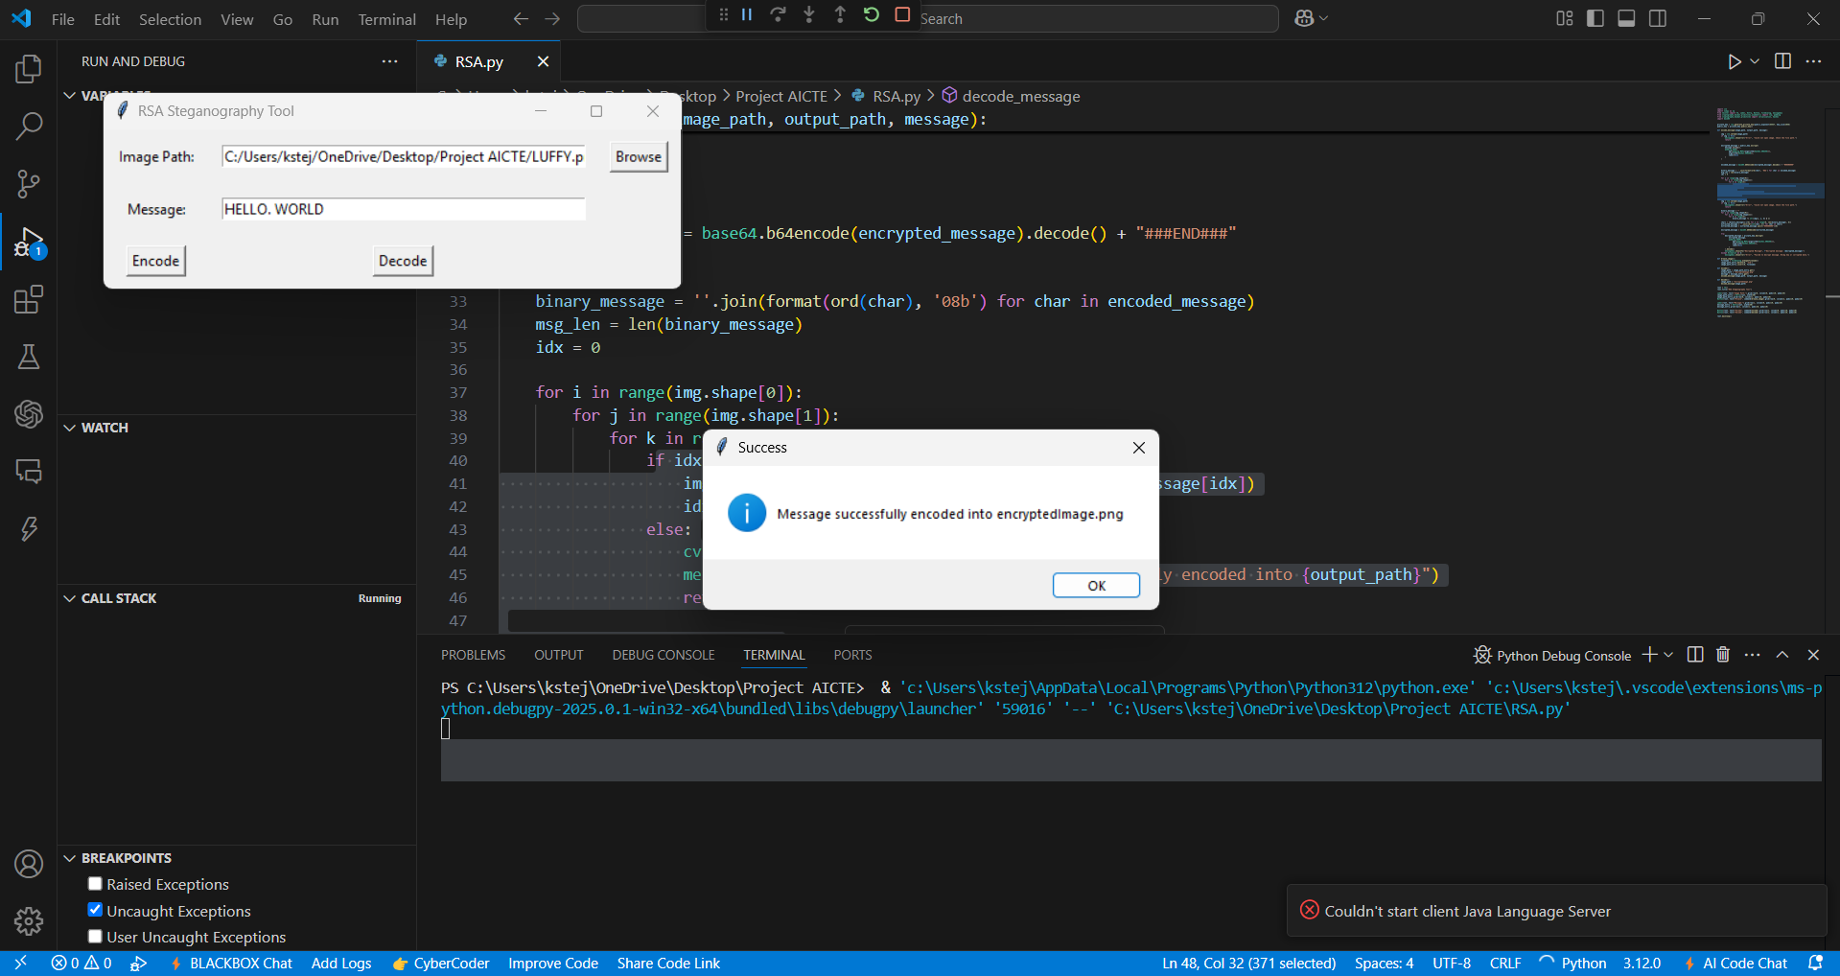
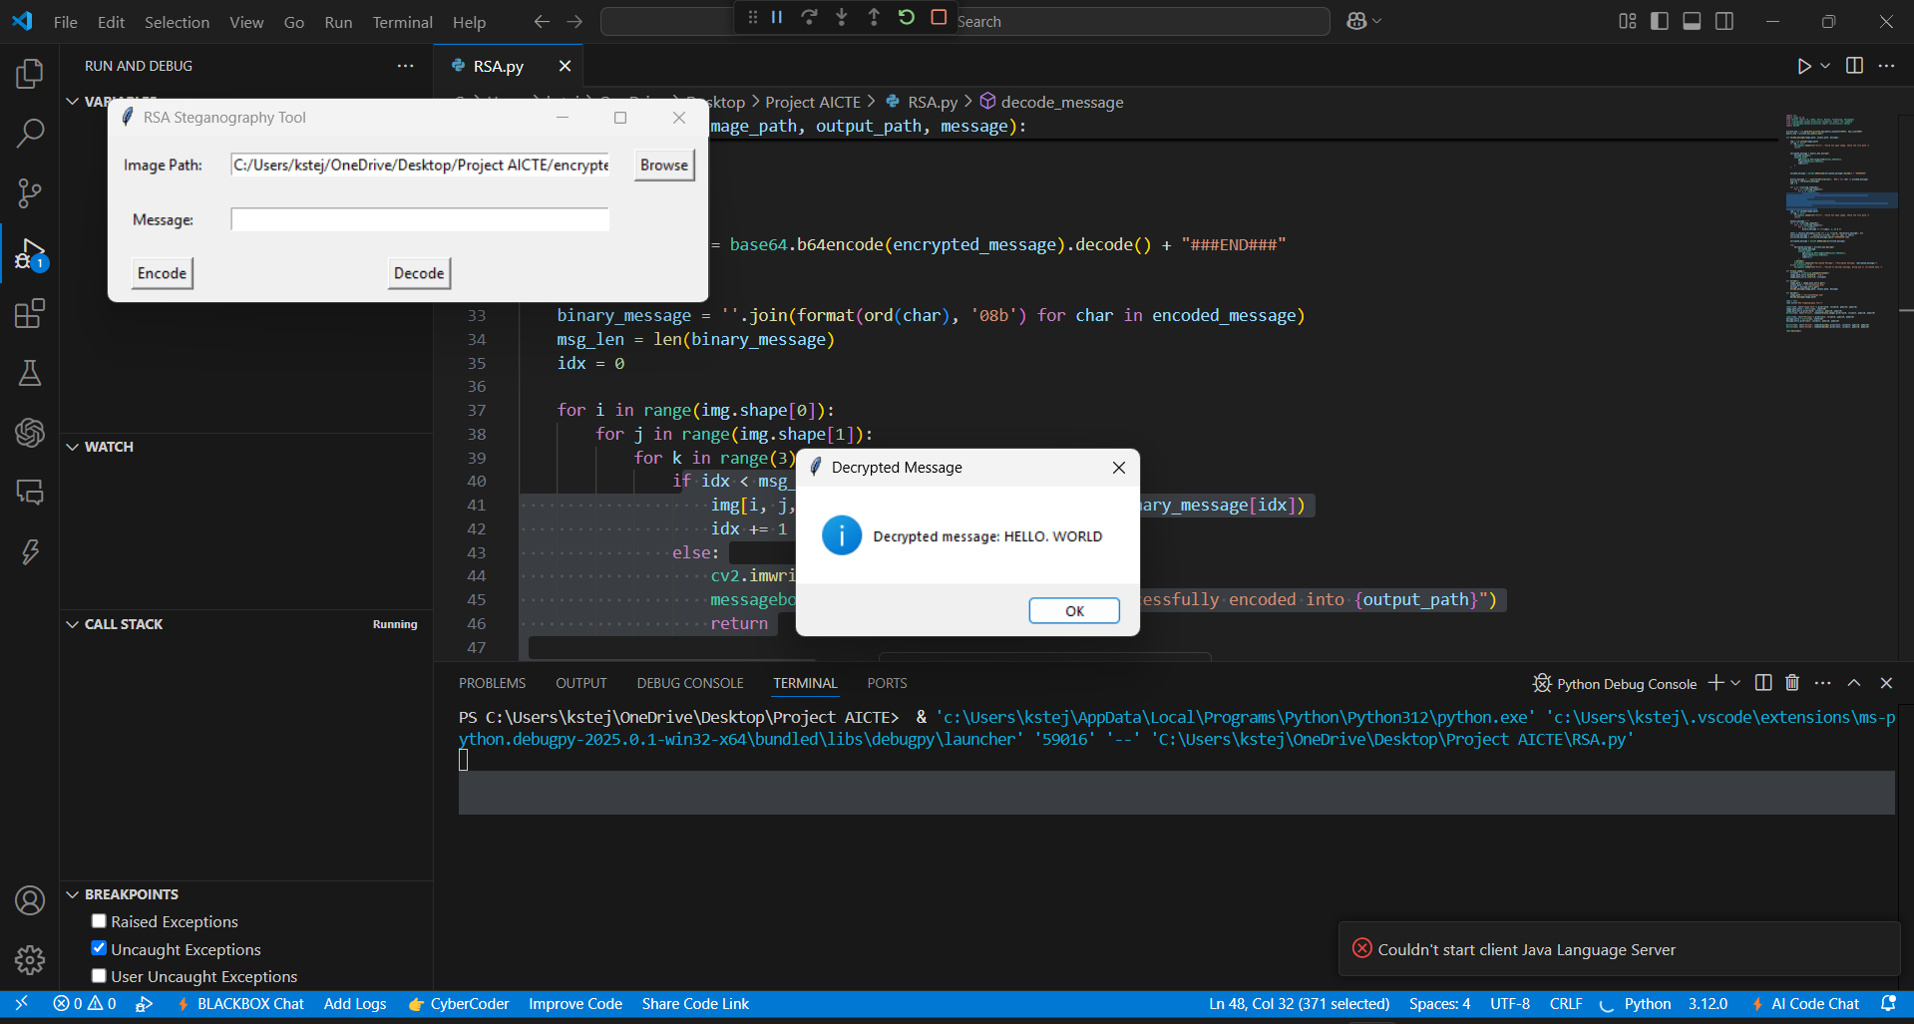
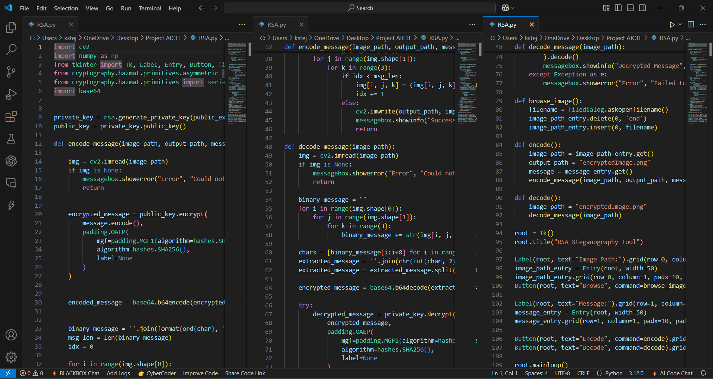
Results

Slide 8
Conclusion
The RSA Steganography Tool effectively hides encrypted messages within images.
It provides an added layer of security, making it difficult for attackers to detect or decrypt messages.
The project showcases a practical approach to securing communication through cryptography and steganography.

Slide 9
GitHub Link
Repository: https://github.com/TejashAdhithya/Steganography.git

Slide 10
Future scope(optional)
Enhancing the GUI with more advanced features.
Extending support for video steganography.
Implementing additional encryption algorithms like AES.
Developing a mobile application version.

Slide 11
THANK YOU

